Slide 1
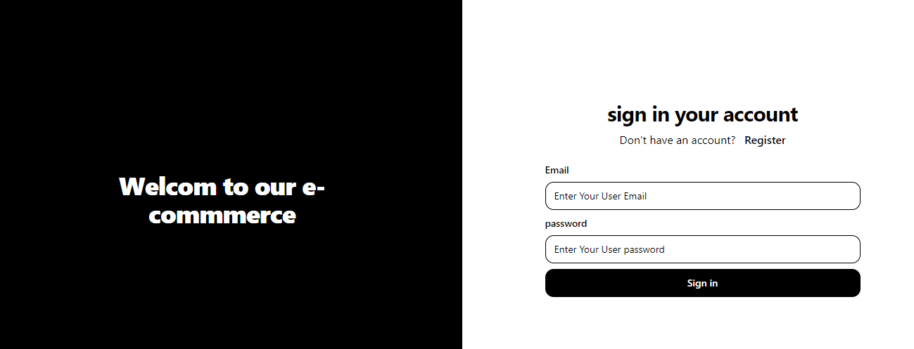
PHARMACY E-COMMERCE APP WITH ADMIN PANEL
Developed by Ayman Mohamed & Abdallah Saber
https://e-commerce-mern-stack-1-zyrk.onrender.com/
Supervised by Eng. Mohamed Mahmoud
AST Company

Slide 2
Introduction
Purpose of the App
Target Audience
Live Status.

Slide 3




Technologies Used
Frontend: React for building the UI, Redux Toolkit for state management, Tailwind CSS for styling.
Backend: MongoDB for handling data storage and retrieval.
Visuals: Logos of React, Redux Toolkit, Tailwind CSS, MongoDB.

Slide 4
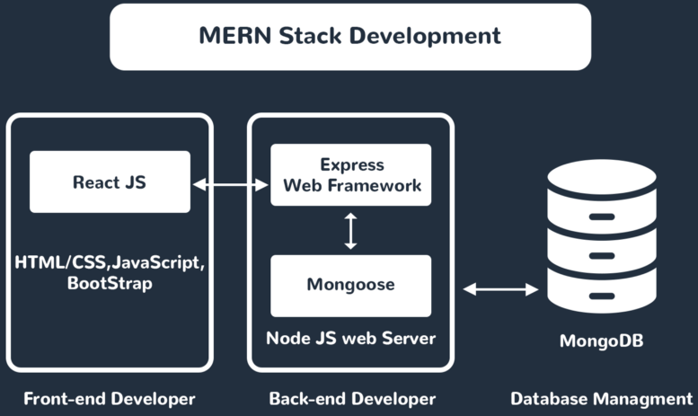
Team Roles
Team Structure: We are a team of two, each contributing to the development and deployment of the app.Our
Roles:
Ayman Mohamed – Full Stack Developer
Abdallah Saber– Backend Developer & DevOps Specialist

Slide 5
Development Process
Ayman Mohamed :
Built the frontend using React, ensured responsiveness, and implemented state management with Redux Toolkit.
Worked on the admin panel for inventory and order management.
Set up the MongoDB database and collaborated on deployment.
Abdallah Saber:
Designed the API architecture and handled the backend server.
Took lead on deployment, ensuring smooth transition to a live environment.
Managed database migrations and server security.

Slide 6



Docker and Deployment in AWS EC2
Why Docker?
Containerization ensures consistent environments for development, testing, and production.
Simplifies dependency management and reduces the risk of version conflicts.
Enhances scalability, allowing for easy deployment of multiple instances.
Deployment in AWS EC2:
Deployed the pharmacy e-commerce app on AWS EC2 to leverage cloud infrastructure.
Configured security groups and networking settings to ensure secure access.
Docker containers were utilized for both the frontend and backend, streamlining the deployment process.

Slide 7
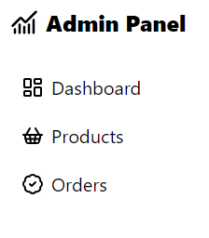
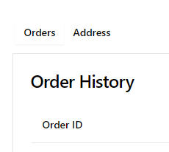
App Features
Customer Side: Walk through the customer-facing features—browsing products, adding to cart, and checking out.
Admin Panel: Highlight how admins manage product listings, update stock, and track orders.

Slide 8
Why These Technologies?
React & Redux Toolkit: Chosen for fast, scalable user experiences.
Tailwind CSS: Provides modern, responsive designs with minimal effort.
MongoDB: Allows for flexible, scalable data management, perfect for e-commerce

Slide 9
Conclusion
Summary: The app is now live, and we successfully created an efficient e-commerce solution for pharmacies with a user-friendly interface and a powerful admin panel.
Next Steps:
- Encourage user feedback for further improvements.
- Discuss plans for future updates or features.

